Slide 1
E-Commerce Website for Automotive Parts
Name: Sanjai.S (Enrollment No : EBEON0322574368)
Name : Jishnu Nambiar (Enrollment No : EBEON0322578300)
Name :- Sudhir Kumbhar (Enrollment No : EBEON0322584185)
Name: Sateeswarbabu Katem (Enrollment No :EBEON0322571885)
Name: Ranjini Devi.R (Enrollment No : EBEON0322579232)
Guided by :
Mr. Vardharajan

Slide 2
Introduction
Auto Parts plus is an user friendly ecommerce website which provides users an option to buy any automotive parts for their vehicle from online, within few steps.
As an admin you will be able to add your on categories and product in the website which will be displayed to the user for buying.
We have also included an online payment option which will help user to pay for the products online itself.

Slide 3
Software and Hardware Requirements
Software Requirements
Eclipse IDE
Programming language- Java
Spring Boot.
JDK 17
Frontend - HTML, CSS, Bootstrap, java script.
Database - MySQL
Hardware Requirements
Processor - Ryzen 5
Speed - 1.8GHz
RAM - 4GB (minimum)
Hard disk- 50GB

Slide 4
E-Commerce Website for Automotive Parts
Modules:
Homepage
Login and Registration
Shop
Cart
Payment
Admin Module
Chatbot

Slide 5
E-Commerce Website for Automotive Parts
Modules and Submodules
Admin Module.
Upload the product details to database
Upload the product image
We can see the all product in product section
Update the product detail that already uploaded.
Chatbot.

Slide 6
Continued...
Goal of module:
Admin product is the place that upload the product which were seen in the website.
Here we can upload the product and product details.
Get all the product detail from the database.

Slide 7

Goal of module
Chatbot is one of the main feature of our project.
This is clear the doubts about the shopping to users.
If user has any doubt about purchasing the products in the website they can ask to the chatbot ,it will clear the user doubts.

Slide 8
Admin(1st Module)
Definition:
Admin page is the control of the all the product and the product details.
We can add the products by the category .
Also we can update the already uploaded details of the product.
Sub module details :
Navigation Bar which has a connection with admin home page, logout.
By this navigation bar we can directly go to adminHome without need of back button.
Module Interconnection details :
Here the navigation bar is present throughout the module so it is connected to AdminHome and logout.

Slide 9
ChatBot (2nd Module)
Definition :
At the most basic level, a chatbot is a computer program that simulates and processes human conversation (either written or spoken), allowing humans to interact with digital devices as if they were communicating with a real person.
Now a days ChatBot is one of the most necessary thing in the websites.
It help the user by clarifying the doubts about the shopping.

Slide 10
Continued...
Sub module details :
Chatbot in the chatbot I use the java script for the conversation,
And there is html and css used for develop the interface of the bot.
For responses java script is used ..

Slide 11
Continued...
Sub module details
In admin panel, there is a product table is created for store the all the detail about the products .
For that we create the table with the help of spring, and we use the jpa repository for do the crud operation
We perform the crud operation for delete , add and update the product details

Slide 12
Project overview
.
Admin
User Details
Add Category
Login
Add Product
Logout
Homepage
Shop
Chatbot
Payment
View Product
Add To Cart
Checkout

Slide 13
Tech architecture
1.)Data JPA Security
2.)Oauth2-Client
3.)Thymeleaf
4.)DevTools
5.)Web
1.)HTML
2.)CSS
3.)JavaScript
4.)BootStrap
1.)Java
2.)Spring Boot
3.)Hibernate concepts
Spring Boot
Browser
FrontEnd
BackEnd
Hibernate
MySQL
1.)Object Persistence
2.)Mapping with POJO
3.)Database Connection
1.)DDL
2.)DML
3.)DCL
4.)TCL

Slide 14
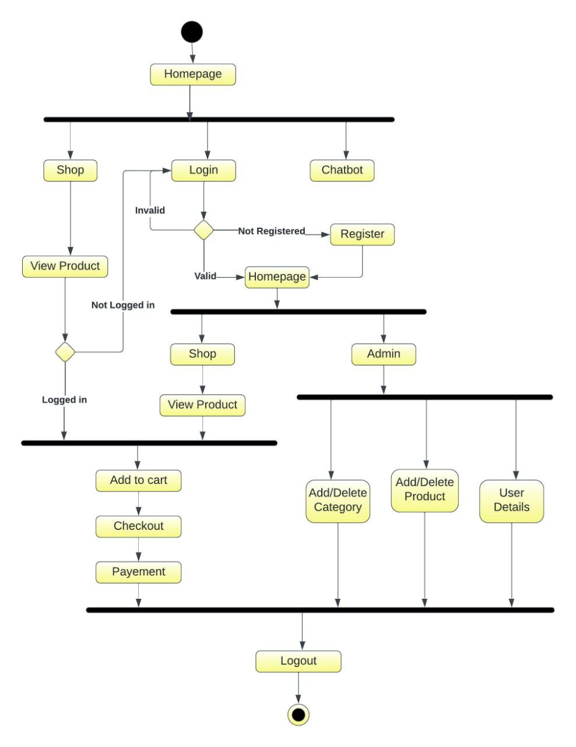
Activity diagram

Slide 15
Challenging issues
While showing the product details to the database, facing the mapping issues. This is resolved by checking properly.
Facing the error while adding the images ,but it did not reflect by refreshing the ide it will solved.
In the chat bot operation of the chat bot is irresponsible because of the wrong mention of the css and js files.

Slide 16
Features about the module
We can add the images and details of the products
We can see all the product and the category details here.
It has a user friendly interface, where the users will find it easy to use.
The chat bot is very helpful for the users
the response of the chatbot is fast.

Slide 17
Future enhancement
Integerate the product suplier details.
Include stock management.
To add Sell product option, where user will also be able to sell their own products.
In chatbot we improve that with a aiml and NLP.

Slide 18
Quality improvement task
Testing aprouch:
Junit basic test validation
DevOp tools:
MySQL Workbench, Github, Maven
UI approach
HTML, CSS, java script, Bootstrap.

Slide 19
Conclusion
In this project we have built an ecommerce website specially designed for automotive parts. With online payment and may more facilities.
Which has user friendly interface for easy use purpose.
We have implemented the CRUD operations with hibernate and spring boot for easy use of the project.
With this we conclude that this project has almost fulfilled all the basic necessities of an ecommerce website.

Slide 20
THANK YOU
Presented By :
Sanjai.S

